Slide 1


Pharmeazy e-pharmacy management system
Team 18:
Kartik Kaul
Shubh Mody
Aditi Pala

Slide 2
Project Overview
Pharmeazy is an e-pharmacy data application where we aim to simplify buying, selling, and delivering over-the-counter and prescription-only medicines over the internet. Also, the user can book physical appointments with qualified specialized doctors.
We created a database consisting of 16 tables comprising users, doctors, sales, drugs, and appointments as some of our preliminary tables.

Slide 3
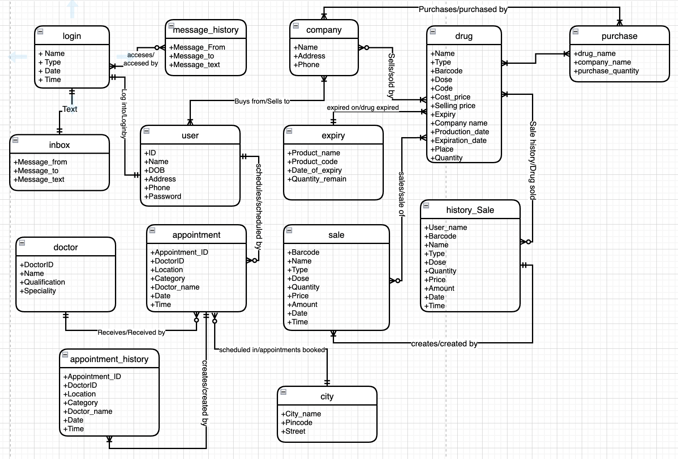
Conceptual Model Diagram

Slide 4
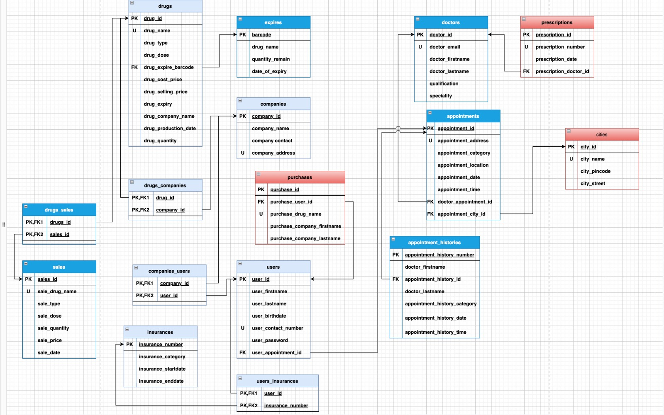
Logical Model Diagram

Slide 5
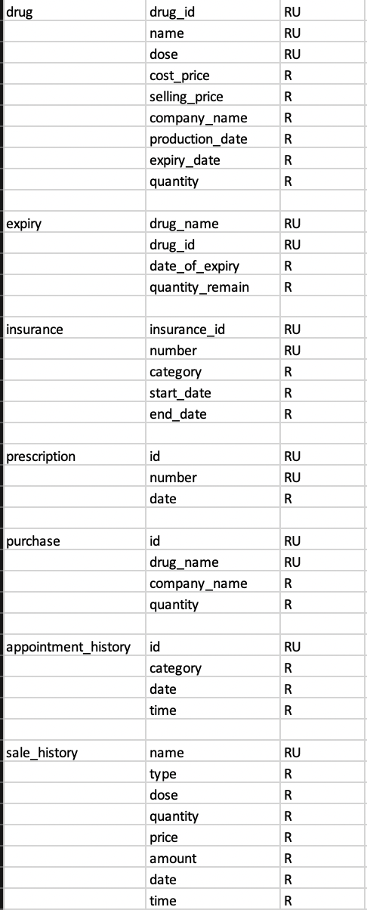
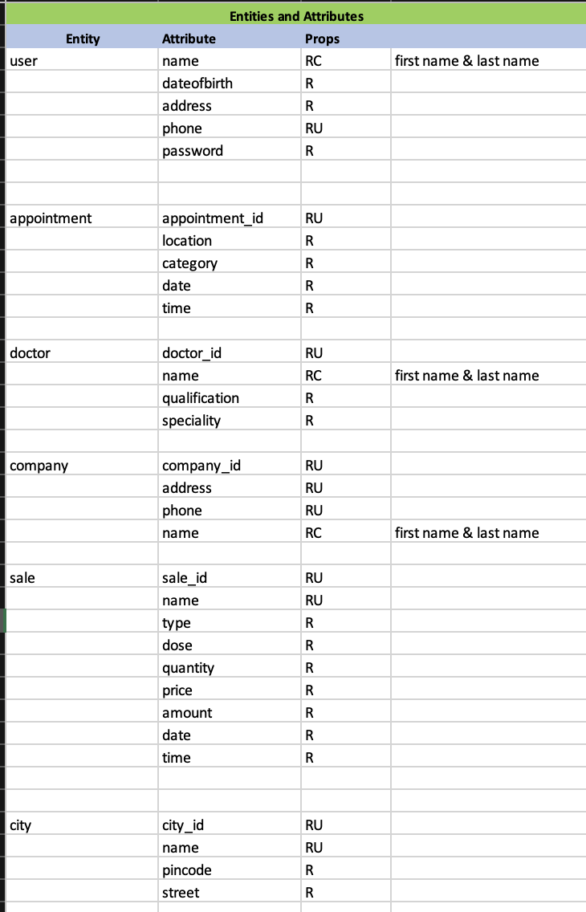
Data Requirements – Entities and Attributes

Slide 6
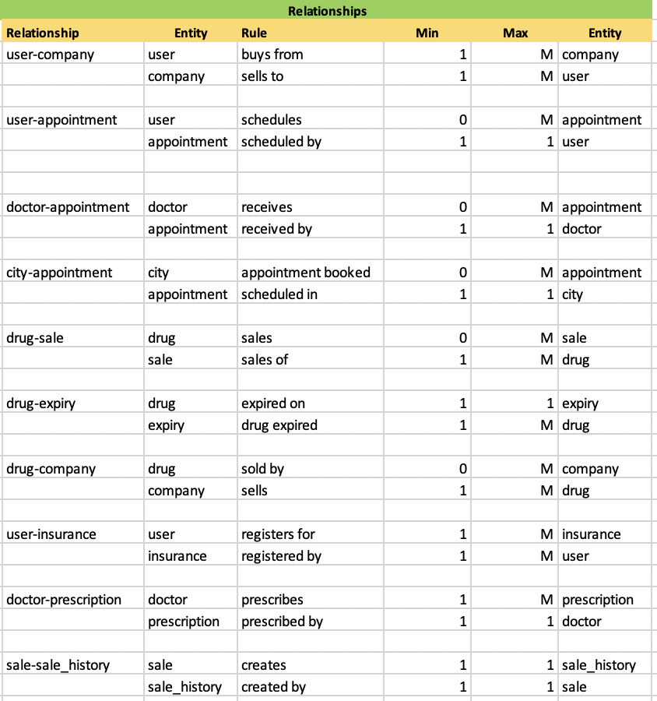
Data Requirements - Relationships

Slide 7
Business Logic
To order medicines:
One person can buy multiple medicines.
Medicines can be bought by multiple users.
To book a consultation appointment:
One person can book 1 appointment at a time.
One Appointment can be booked by 1 person only
To view current appointments and check appointment history:
1)1 person can have 0 or more appointments.
2)1 appointment can be for 1 user only.

Slide 8
Database System Infrastructure
We used the following tools to create and implement this project:
1) Draw.io : We created the entity-relationship diagram for the conceptual model and the logical data model diagram using the draw.io tool. We used this tool to create the entities and for defining their attributes and keys for our implementation.
2) SQL Server: We utilized the SQL server for storing all the tables and their corresponding data. We created tables in the database using SQL queries.
3) Power Apps: Used for building the front end of the application.
5) Azure Data Studio : We used the ADS tool for creating the database and for querying the data to provide insights and analysis for the problem statements.

Slide 9
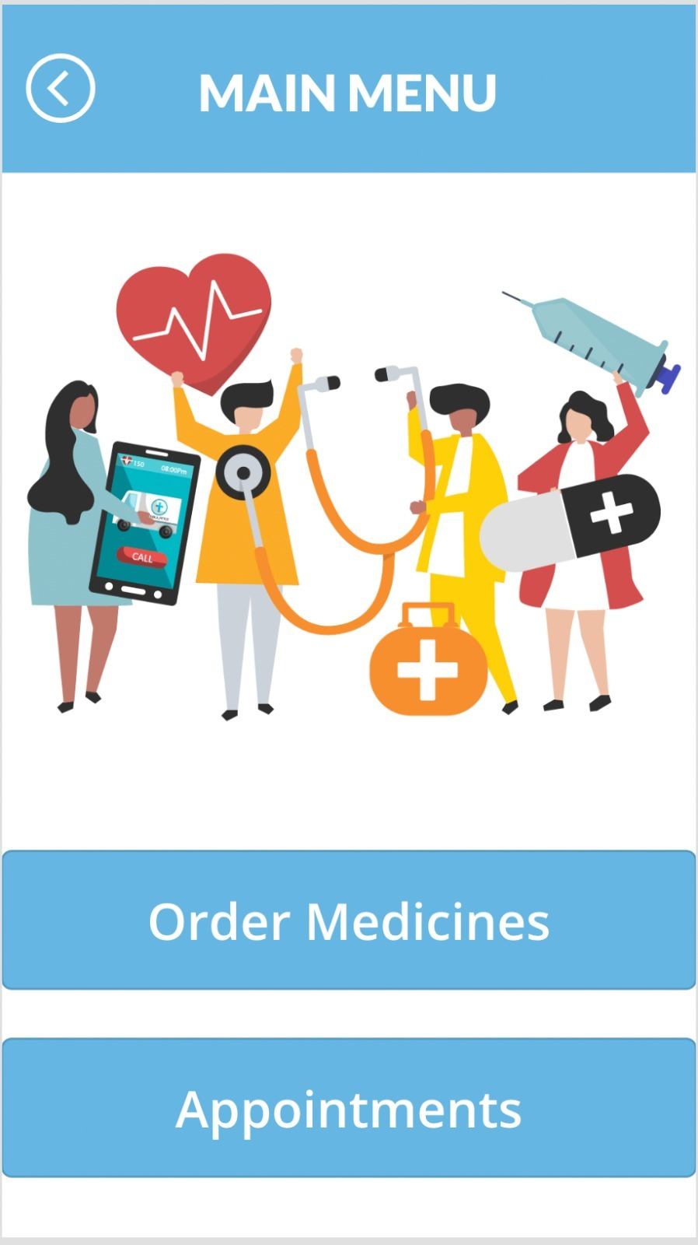
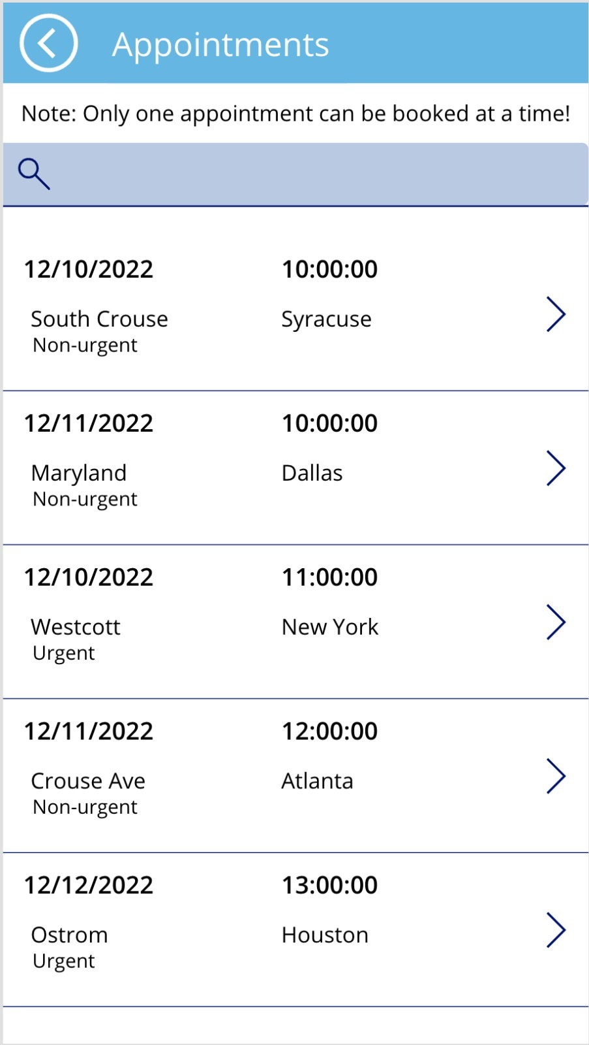

USER STORIES
To book a consultation appointment:

Slide 10
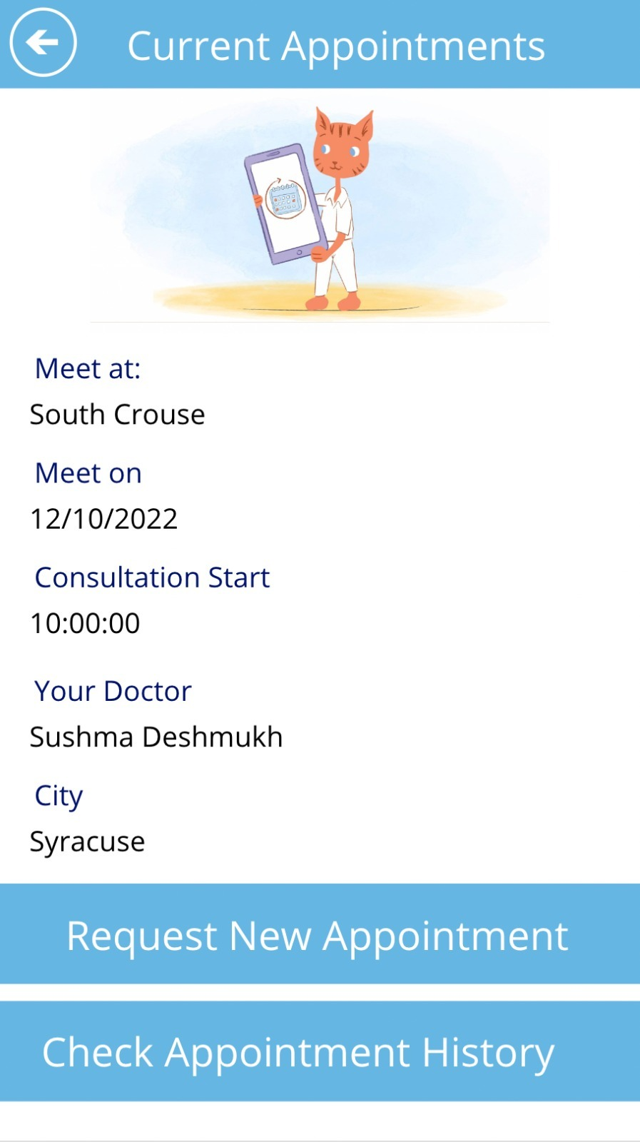
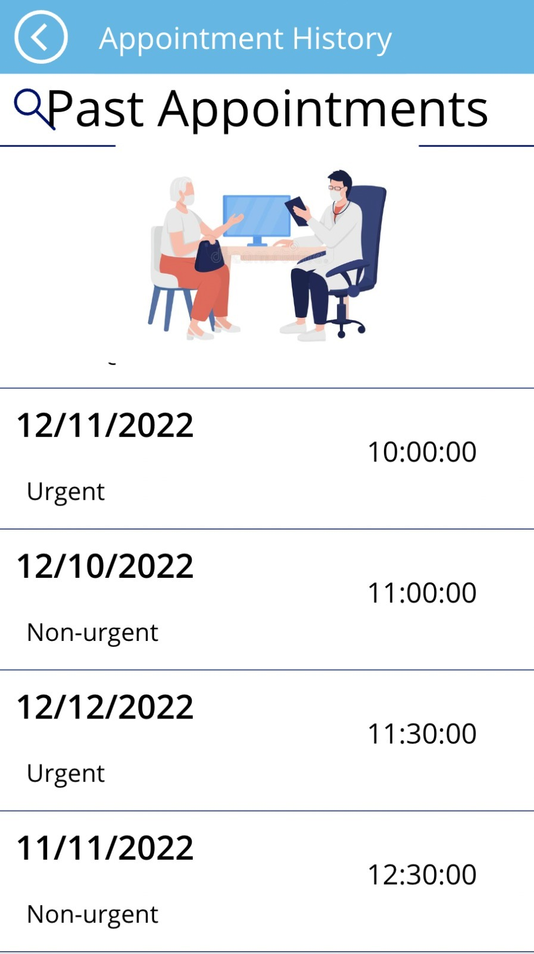
2. To view current appointment and check appointment history:

Slide 11
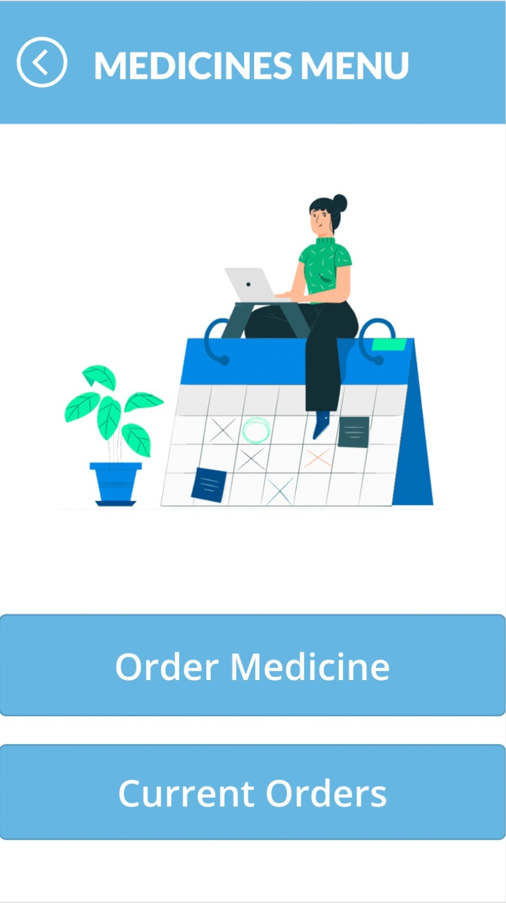
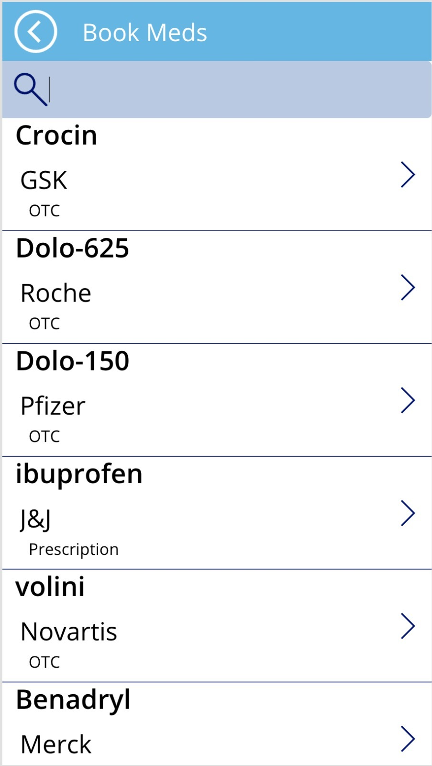
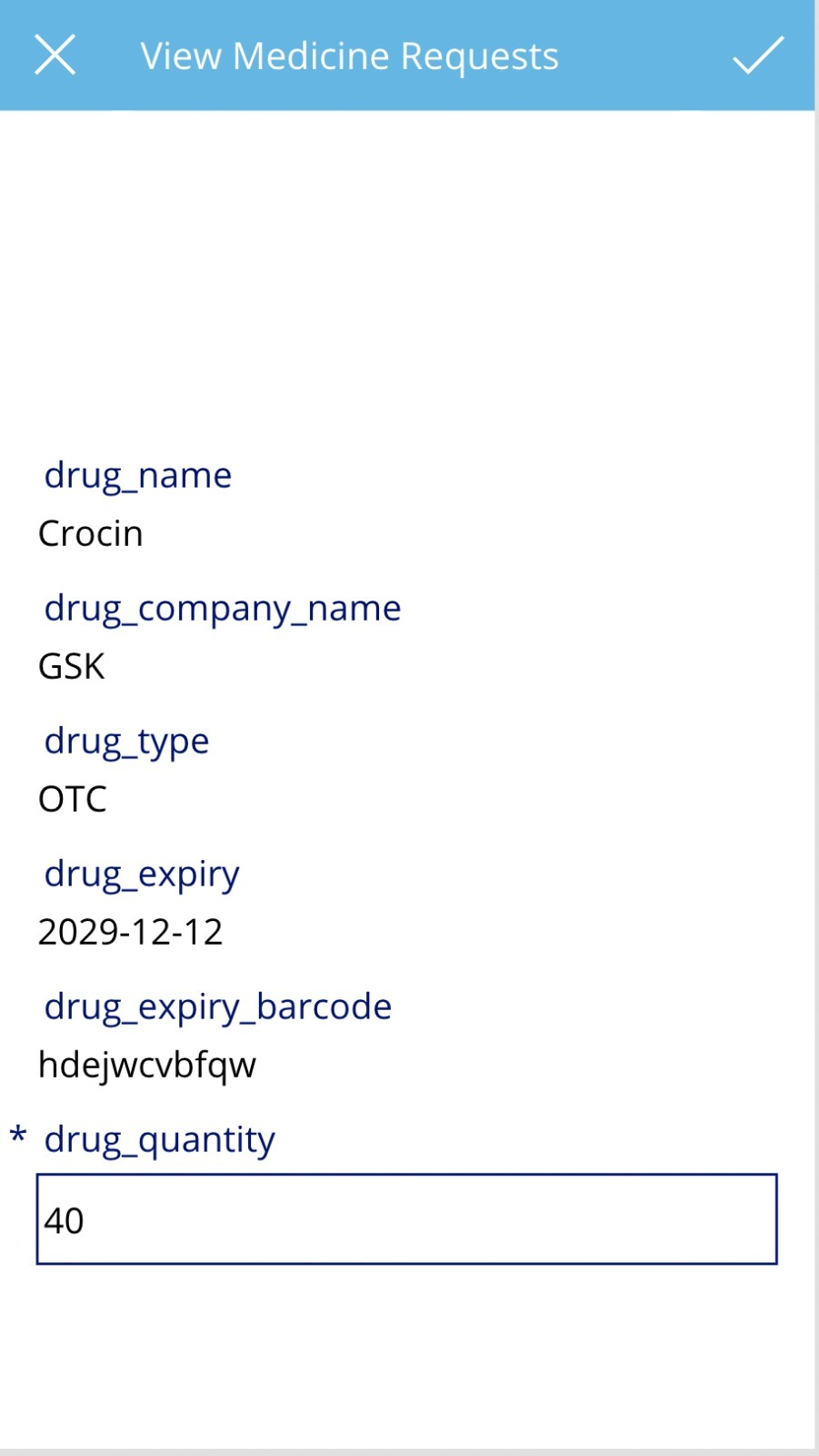
3. To order medicines of required quantity:

Slide 12
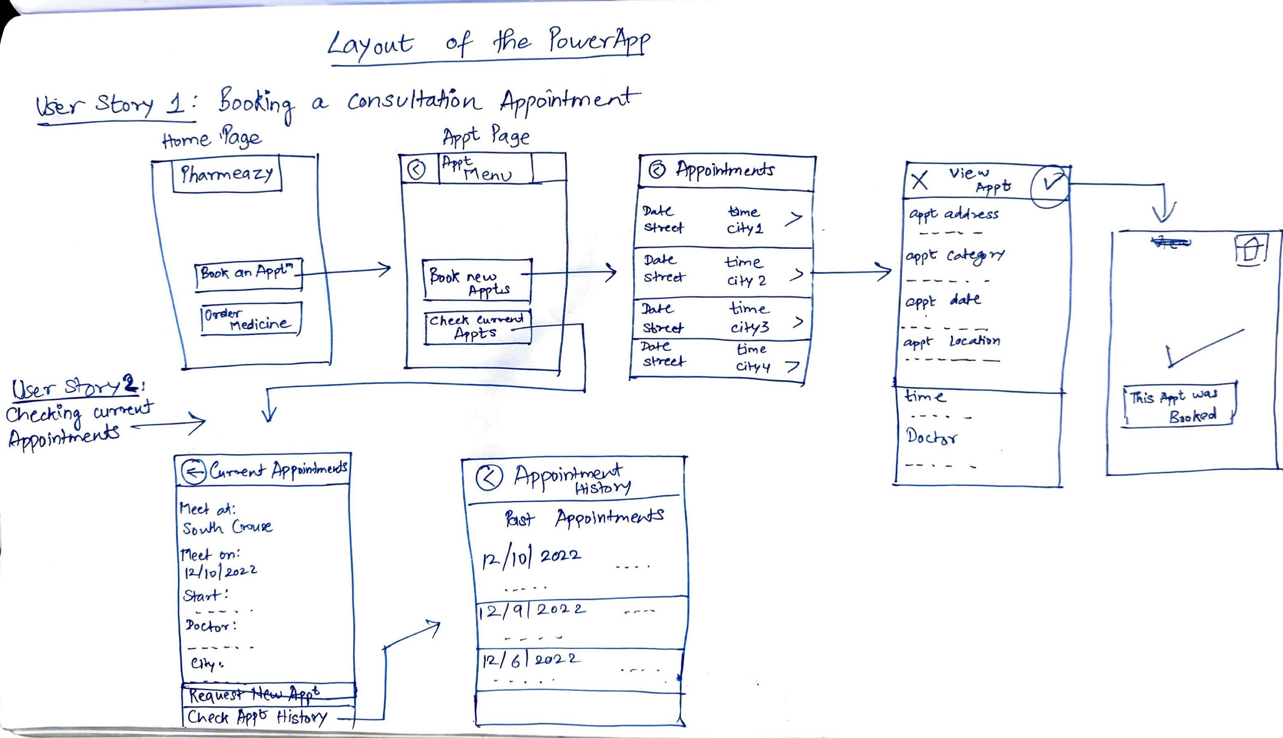
Hand-Drawn Layout of PowerApp

Slide 13
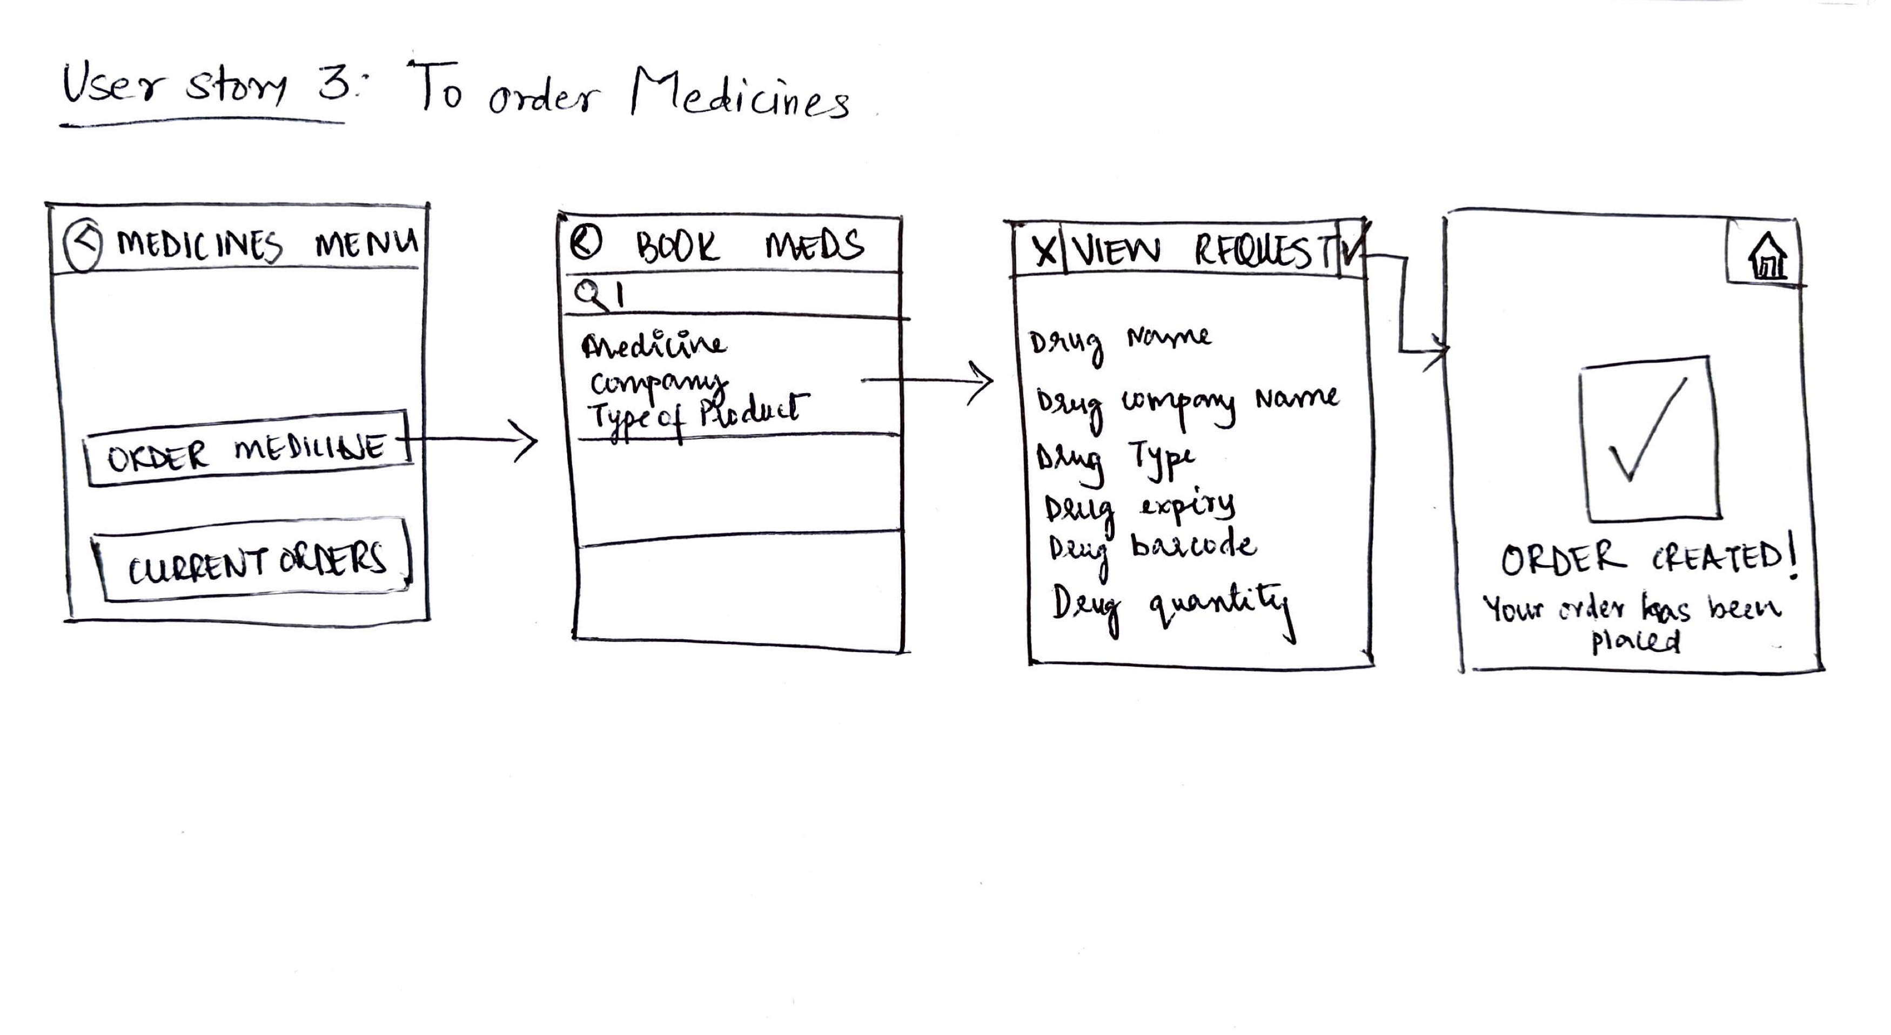
Hand-Drawn Layout of PowerApp

Slide 14
THANK YOU

